Slide 1
Weekly Report
程文胜 2018.12.21-12.28

Slide 2
Weekly Report
Abstract
Content
Discussion

Slide 3
Abstract
This week I mainly put my effort on testing basic models with ISPRS Vahingen and Postdam dataset, and trying to re-implement results of paper.
Vaihingen data

Slide 4
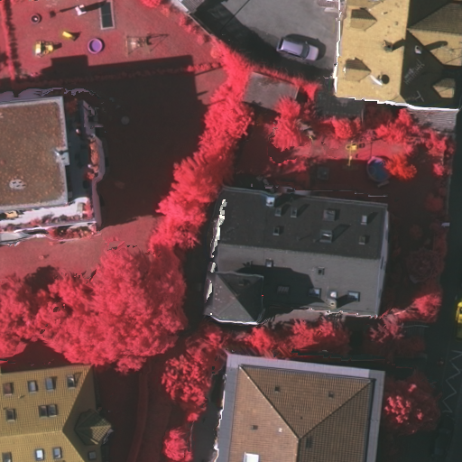
Content
For Vaihingen dataset, there are 16 images for training, and 17 images for testing.
At first, I sliced these 16 images into 512*512 patches, then test baseline models with the data. However, the result still shows that VGG16-based FCN performs about 2% better than ResNet based RefineNet.
Training data

Slide 5
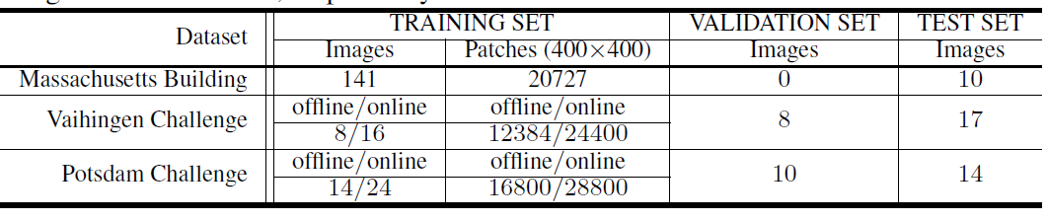
Content
I looked through the paper and found that the author didn’t explain his data augmentation methods in detail. As a result, he got ~12,000 images while I only got ~3,000 images. So I asked the author and he responded to my email, in which he talked about specific data augmentation methods they used.
Detailed dataset size

Slide 6

Discussion
If we have questions about other’s papers, just ask the author. Generally, they would explain to you and you can get the answer fast.
These experiments show that only when dataset size is large enough, eg. ~10,000 images, can deep models like ResNet performs better than shallow models like VGG. So for remote sensing images, we have to use many data augmentation methods to expand the dataset size and then get reasonable results.

Slide 7
Report End
程文胜 VIPG

